Slide 1
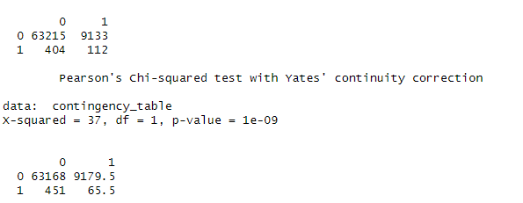
Correlation between the percentage of Group quarters and the prevalence of Food deserts.
Chi-square (GOF) between GroupQuartersFlag and LILATracts_1And10:
Conclusion:
low p-value - reject the null hypothesis
thus there is a significant association or correlation between "GroupQuartersFlag" and "LILATracts_1And10."

Slide 2
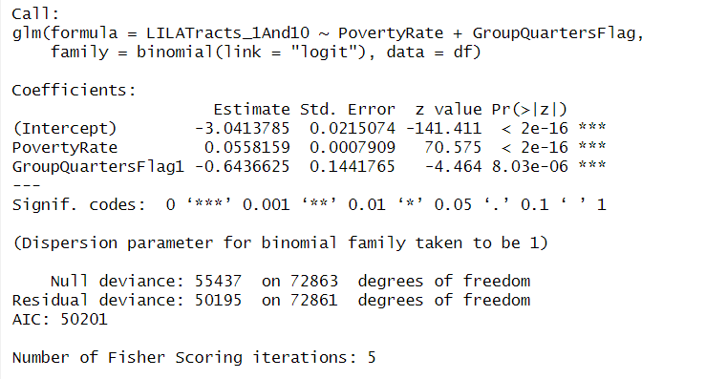
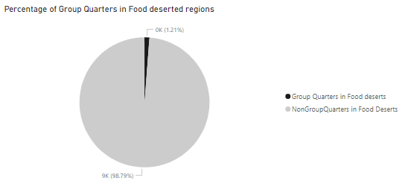
Impact of Group Quarters on Food desert.
GroupQuartersFlag of 1 is associated with a decrease of 0.643663 in the log-odds of the response variable being 1.
For a one-unit increase in GroupQuartersFlag1, the odds ratio decrease by a factor of approximately 0.5253647.
GroupQuartersflag negatively affect the Food deserts likelihood.

Slide 3
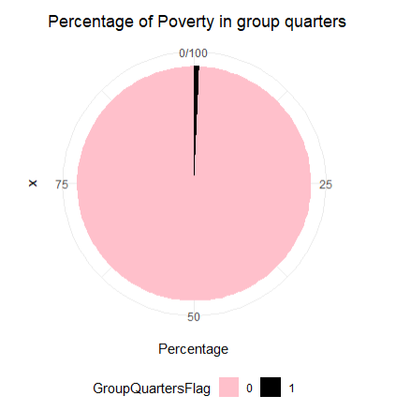
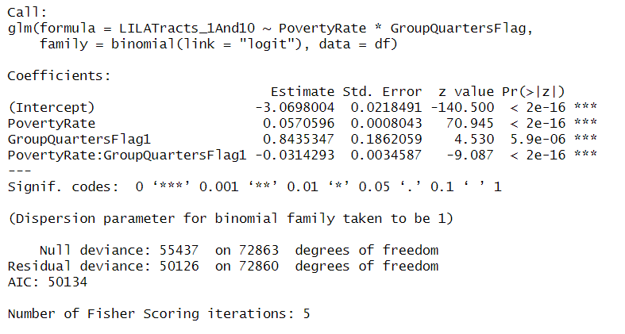
Impact of Group Quarters and Poverty rate on Food desert.
In Non GroupQuarters (GroupQuartersFlag is 0), one unit increase in PovertyRate is associated with a relatively larger increase (0.0570596) in the log-odds of the response variable being 1.
In GroupQuarters (GroupQuartersFlag is 1), one unit increase in PovertyRate is associated with smaller increase (0.0256303) in the log-odds of the response variable being 1.

Slide 4
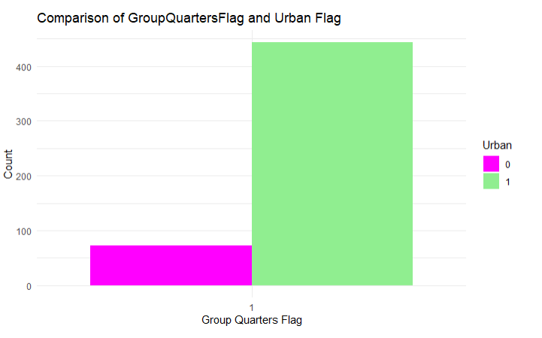
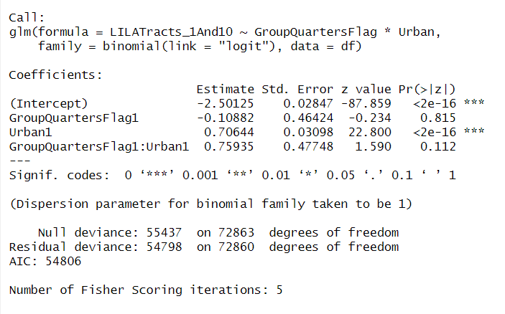
Impact of Group Quarters and Urban on Food desert.
The positive coefficient (0.75935) suggests that the presence of group quarters has a stronger positive effect on the log-odds in Urban, but this effect is not statistically significant at the conventional levels

Slide 5
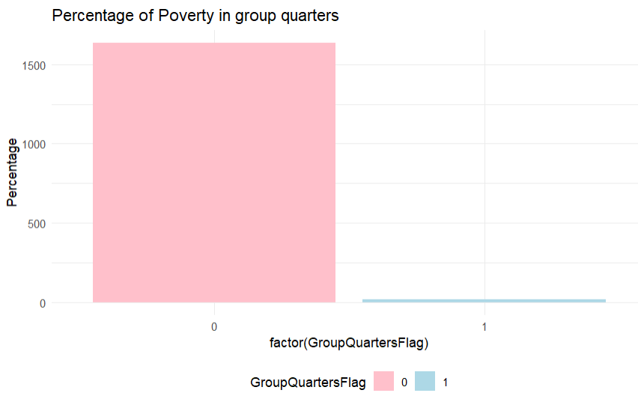
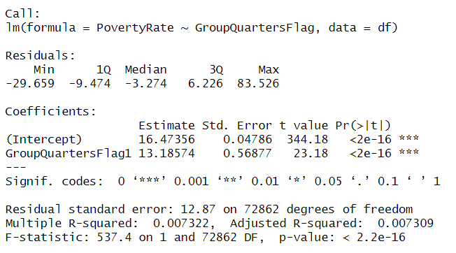
Impact of Group Quarters on Poverty Rate.
The odds ratio for GroupQuartersFlag1 is 532713.2. This value represents the ratio of the odds of the predicted poverty rate when GroupQuartersFlag=1 to the odds when GroupQuartersFlag=0.

Slide 6
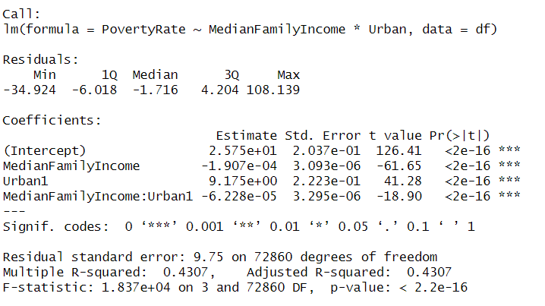
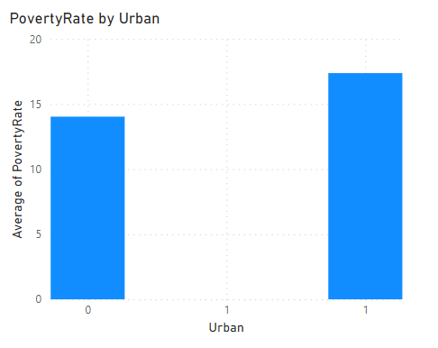
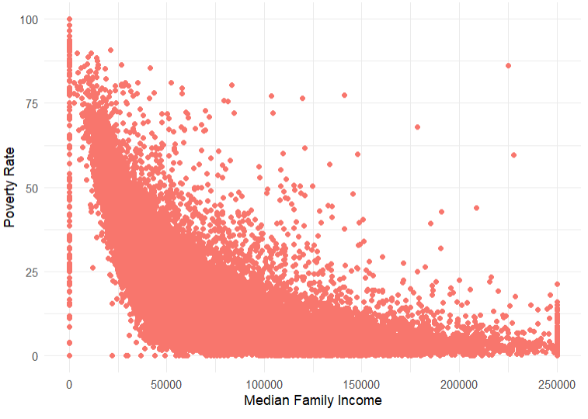
Impact of Median Family income and Urban on Poverty Rate.
Median Family Income increases by one unit, the Poverty Rate is expected to decrease by approximately 0.0001907 units.
Compared to non-urban areas, urban areas have a higher predicted "PovertyRate" by 9.175 units

Slide 7
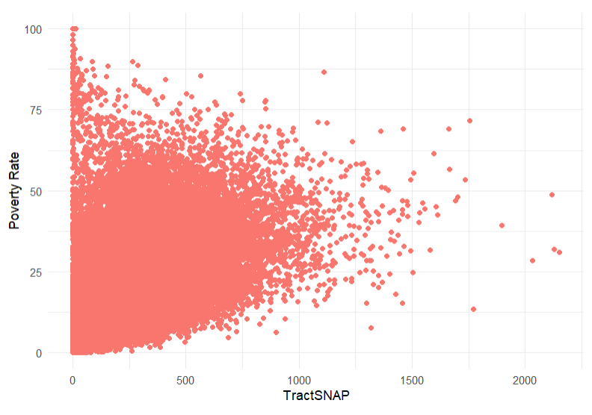
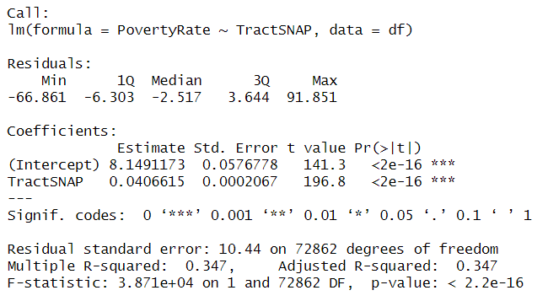
Impact of Tract SNAP on Poverty Rate.
For each one-unit increase in TractSNAP, the predicted poverty rate increases by 0.0406615.

Slide 8
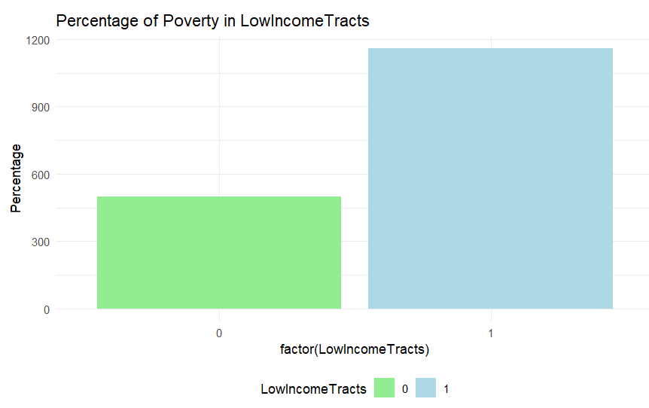
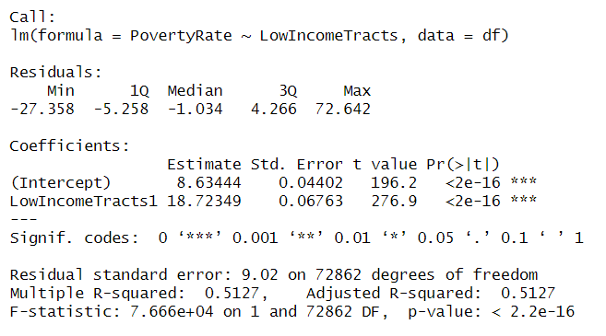
Impact of LowIncomeTracts on Poverty Rate.
The presence of low-income tracts is associated with an increase of 18.72349 unit in the predicted poverty rate compared to areas without low-income tracts.

Slide 9
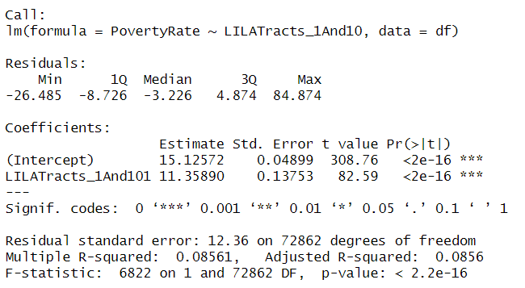
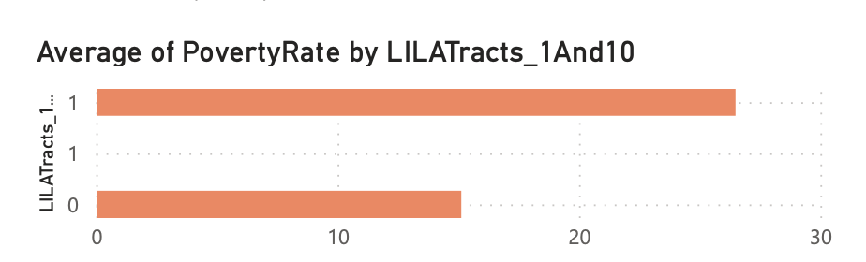
Impact of Food desert on Poverty Rate.
On average, the presence of Food desert is associated with an increase of 11.35890 units in the predicted poverty rate compared to areas without such tracts.

Slide 10
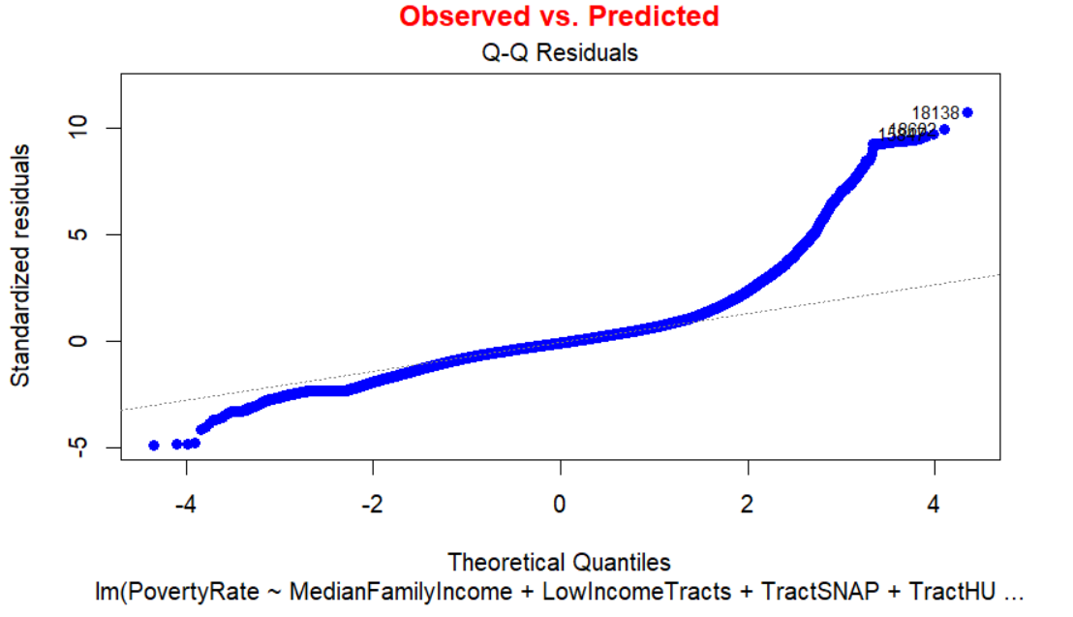
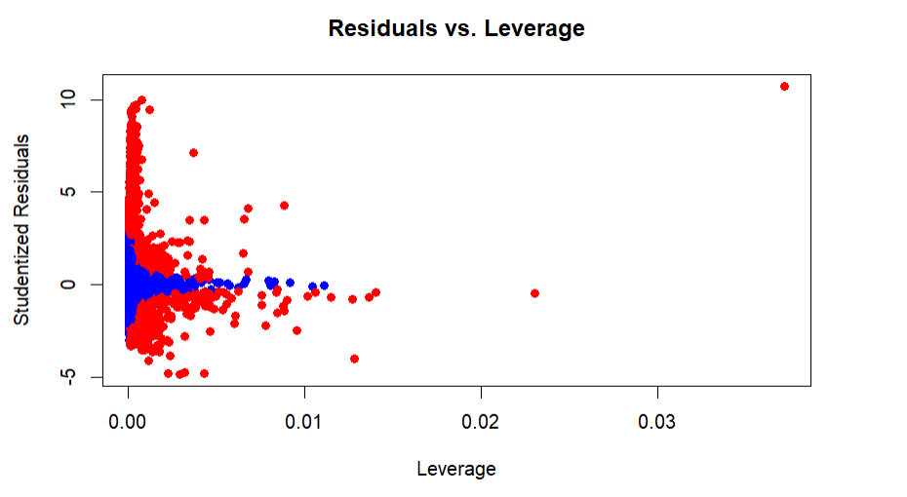
Linearity
Outliers and Influential Points:

Slide 11
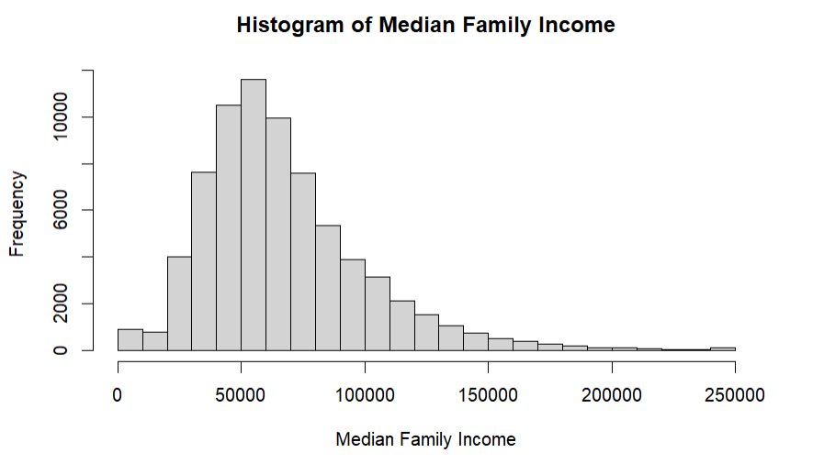
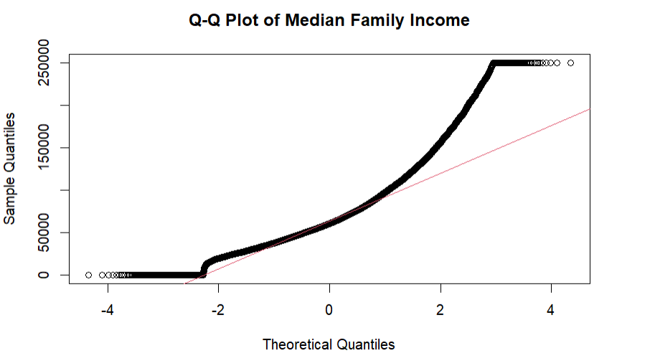
Normality of Median Family income

Slide 12
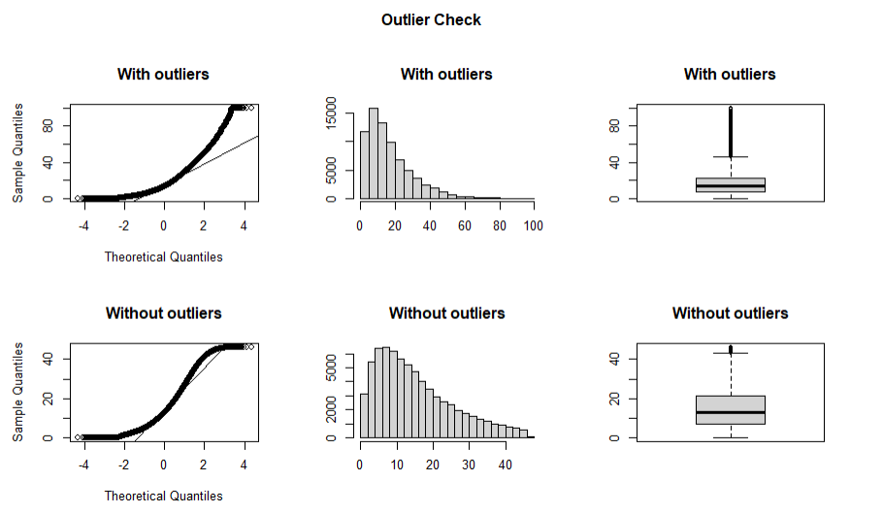
Normality of Poverty rate

Slide 13
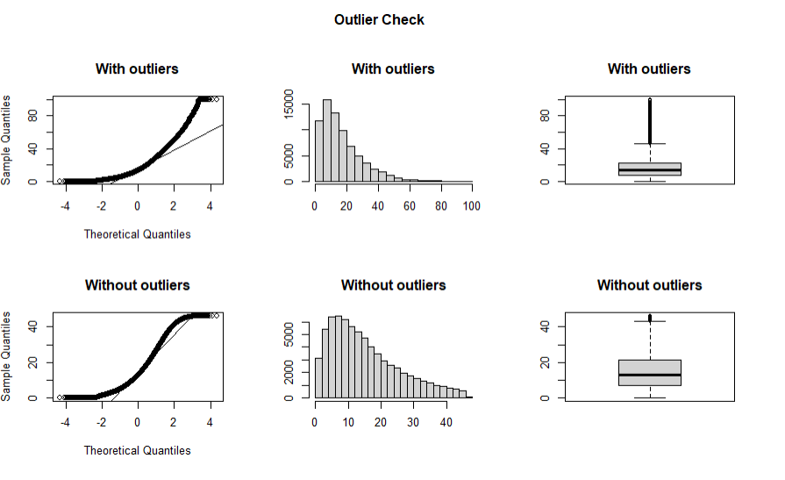
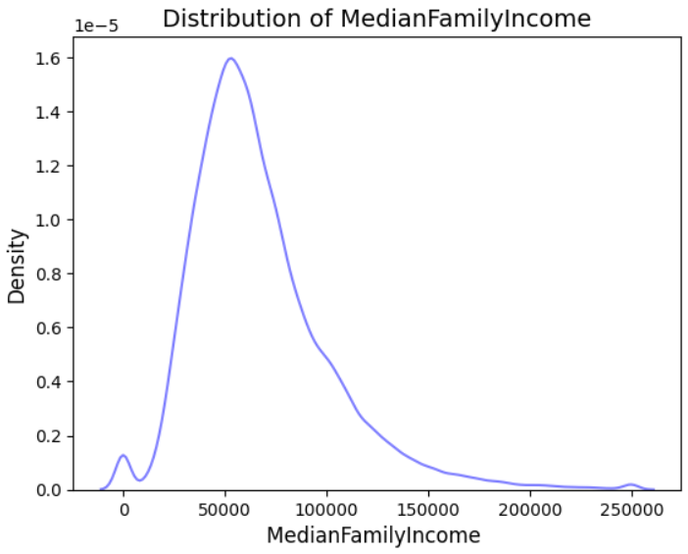
Normality of Median Family income

Slide 14
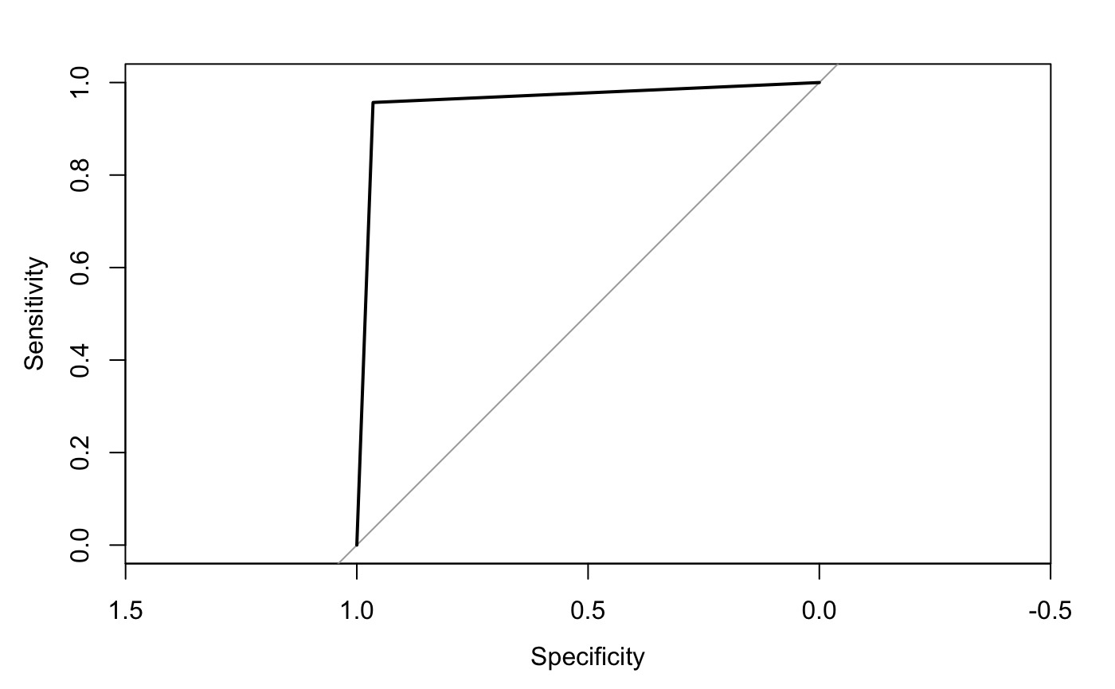
Prediction Models
Logistic Regression for LILA
AIC: 179138
AUC 0.961
Only infs and 0s in the log odds
the small variables are useless and some variables gives perfect separation.
this perfect separation may because the lila is derived from lowincome
As LILA is derived from lowincometract.
c("State","County","Urban","GroupQuartersFlag","lahunv1share","PCTGQTRS","MedianFamilyIncome","lawhite1","lablack1","laasian1","lahisp1","lanhopi1","laomultir1","laaian1","lakids10","lakids1","TractKids","laseniors1","laseniors10","TractKids","TractSeniors","TractWhite","TractBlack","TractAsian","TractNHOPI","TractAIAN","TractOMultir","TractHispanic","TractHUNV","TractSNAP", "PovertyRate")

Slide 15
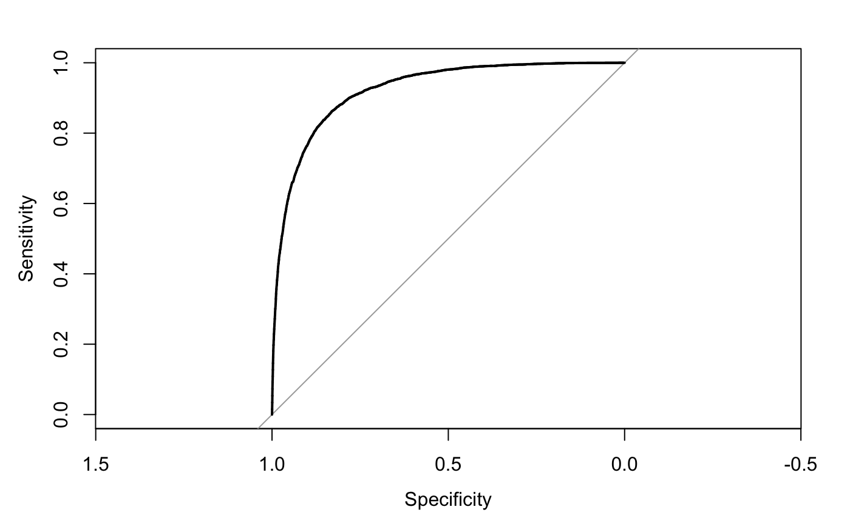
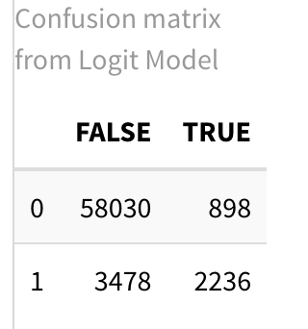
Stepwise Logistic Regression on LILA
Null deviance: 43179 on 67542 degrees of freedom
Residual deviance: 24885 on 67521 degrees of freedom
AIC: 24929
glm(formula = LILATracts_1And10 ~ lahunv1share + MedianFamilyIncome +
Urban + laseniors10 + laomultir1 + TractHUNV + TractSNAP +
TractHispanic + lakids1 + TractWhite + lablack1 + GroupQuartersFlag +
PovertyRate + lahisp1 + TractAIAN + laseniors1 + TractSeniors +
TractOMultir + TractKids + TractBlack + lakids10, family = binomial(link = "logit"),
data = cleaned_data)
Area under the curve: 0.922

Slide 16
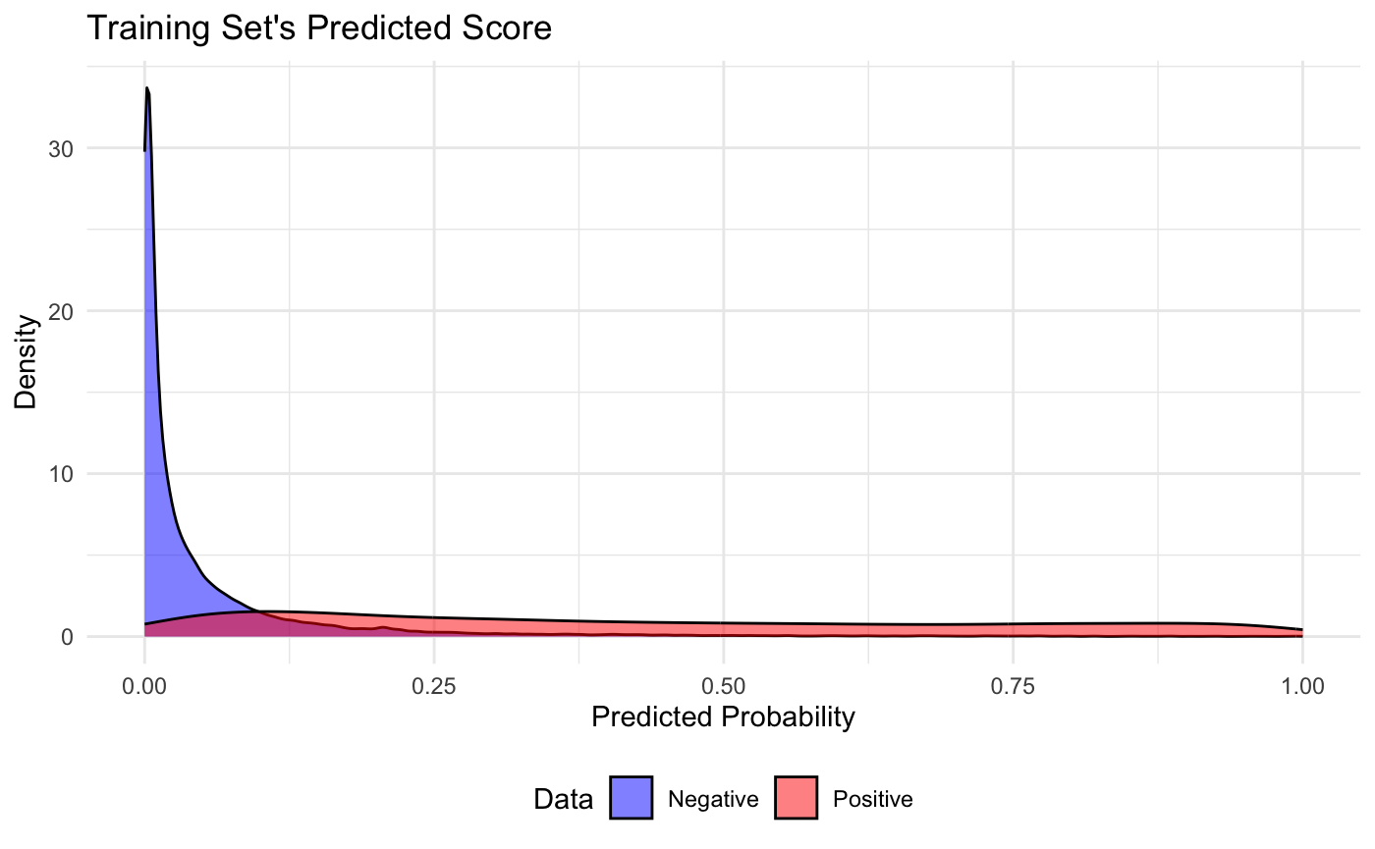
Youden’s Index
Cut off 0.08
0.30786 precision
0.87071 recall
0.82149 accuracy

Slide 17
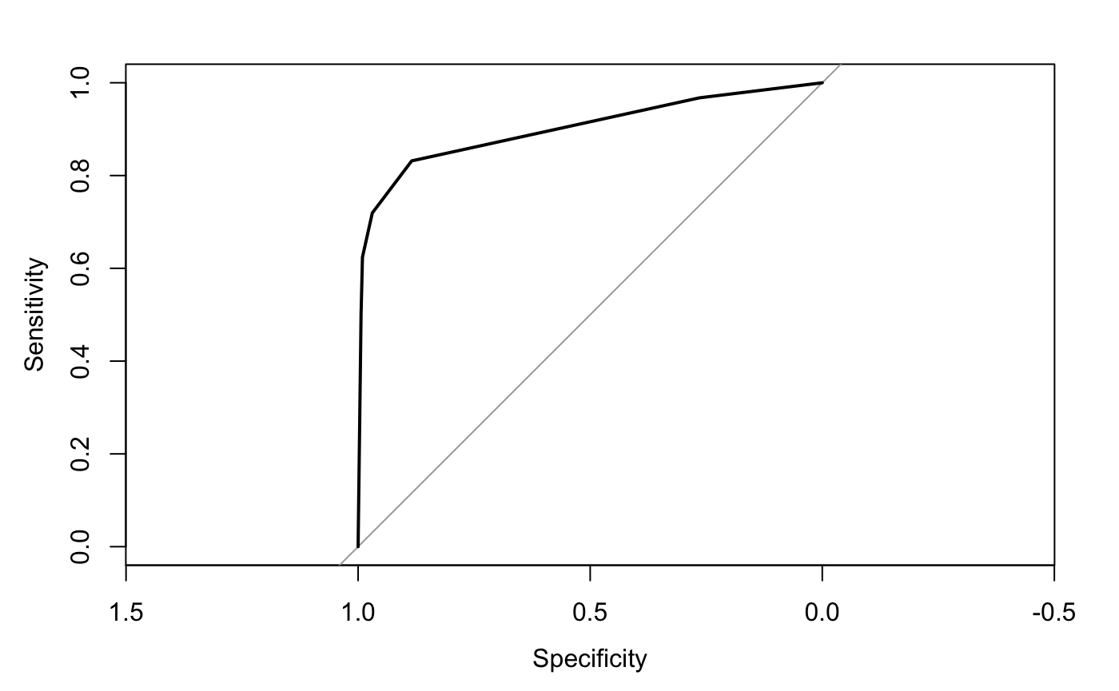
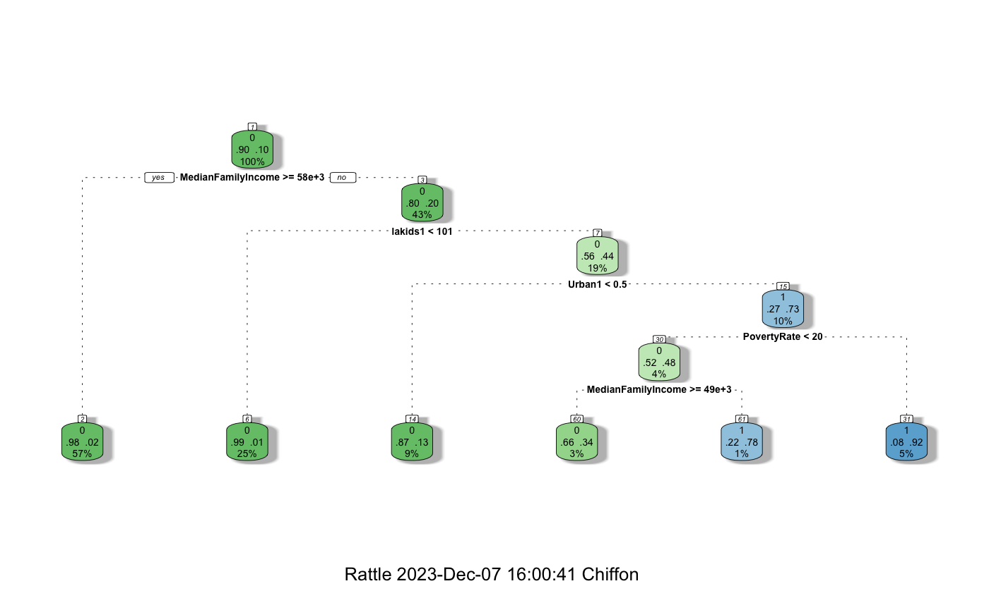
LILA CART
AUC 0.901

Slide 18
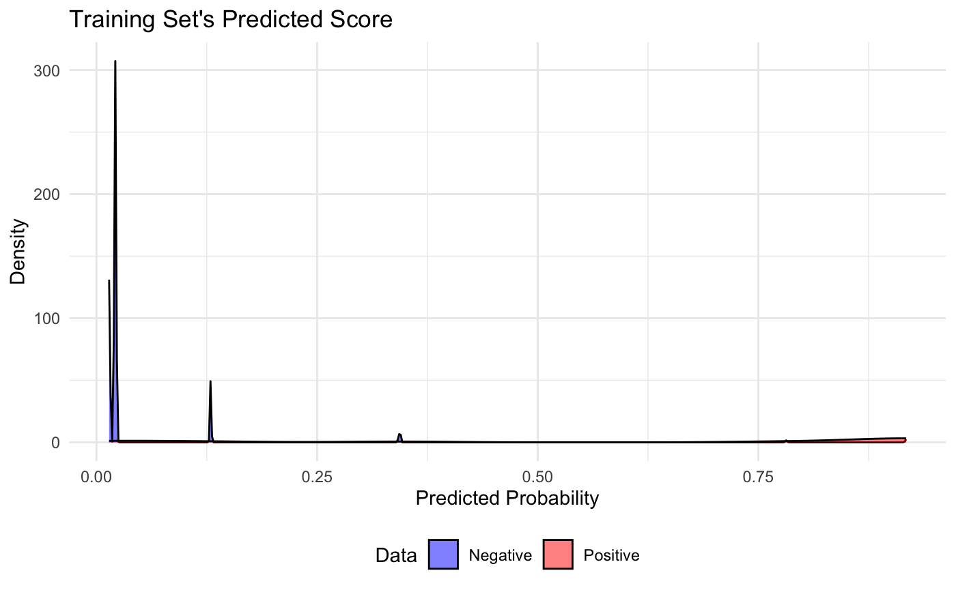
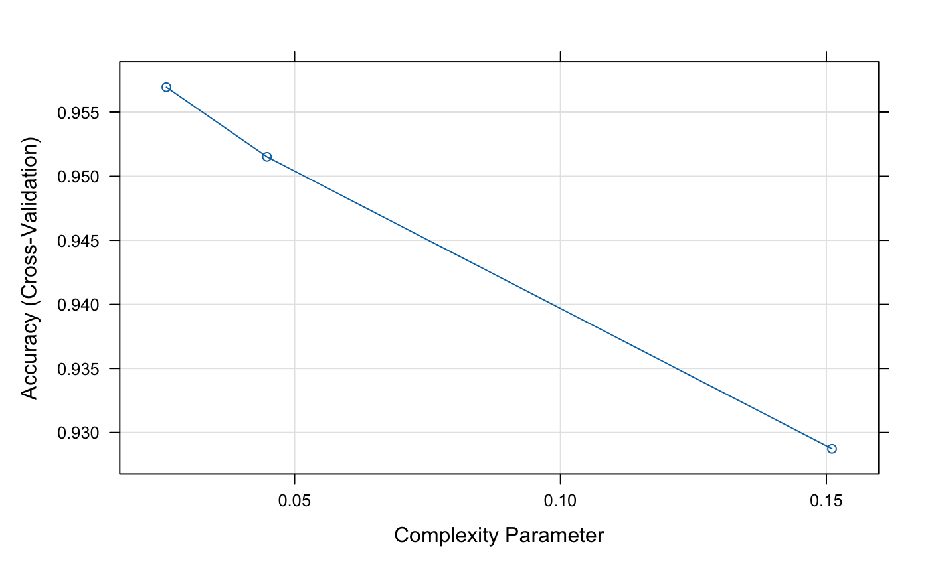
Youden’s index
Best Cut off:
0.07
Precision : 0.43029
Recall : 0.83996
Accuracy : 0.89117

Slide 19
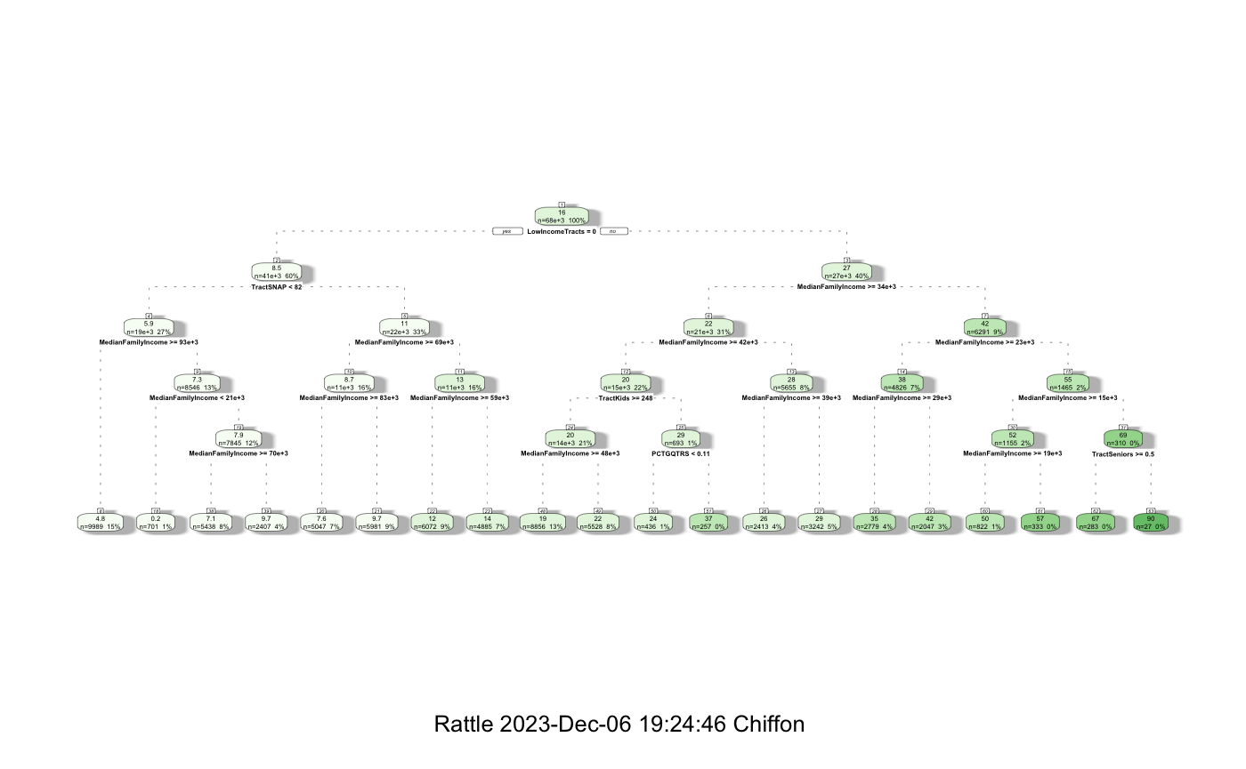
CART Poverty Rate

Slide 20
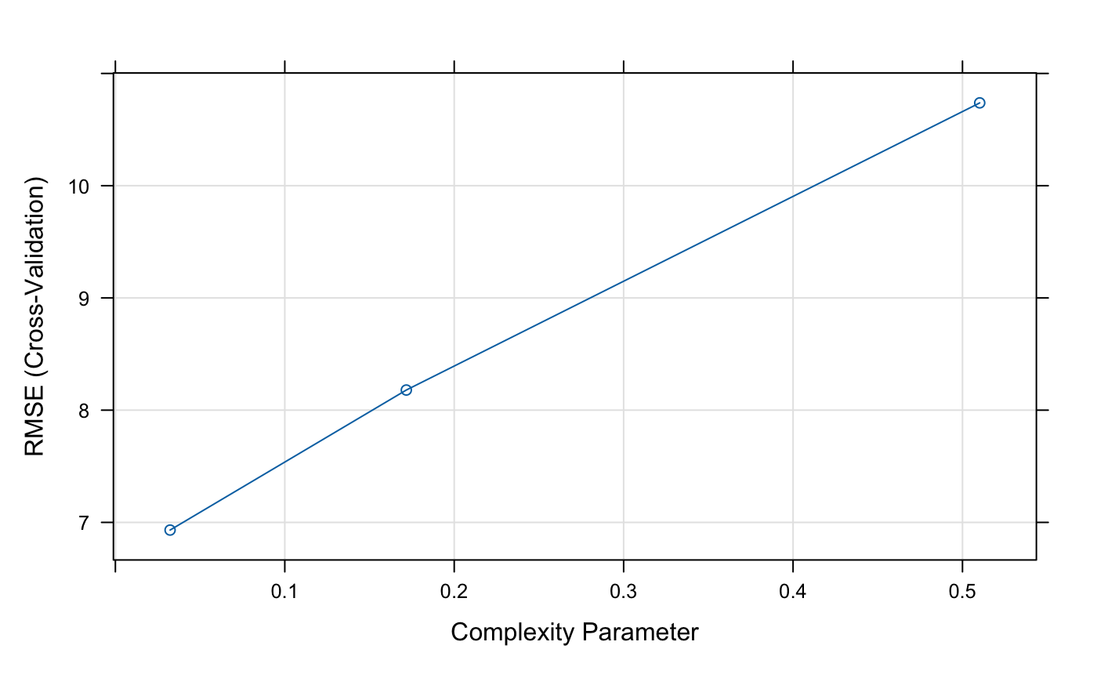
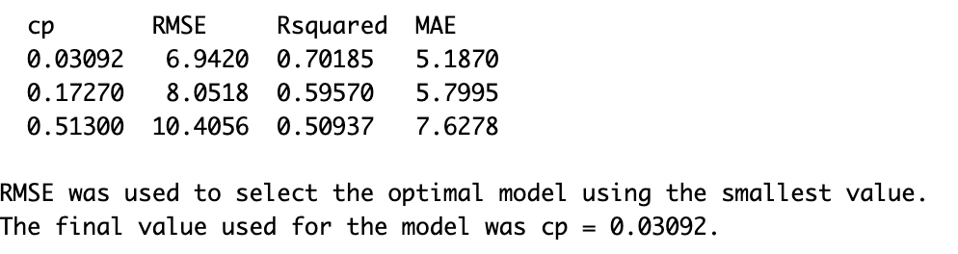

Slide 21
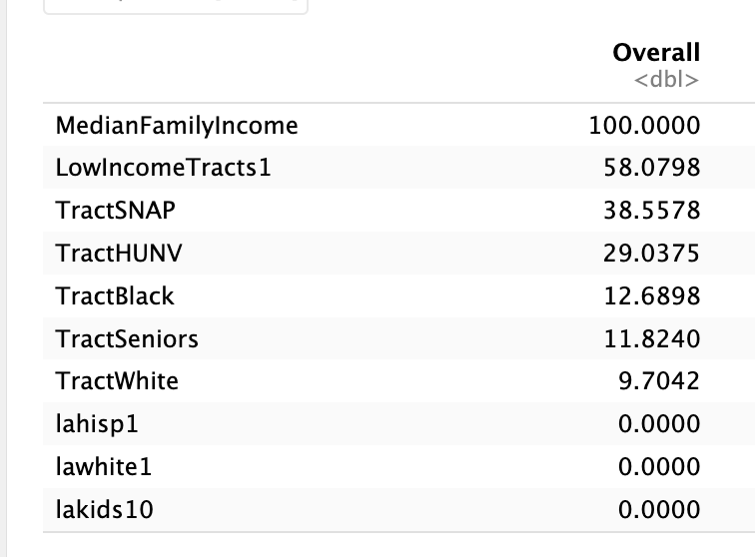
Important Variables from CART for Poverty Rate

Slide 22
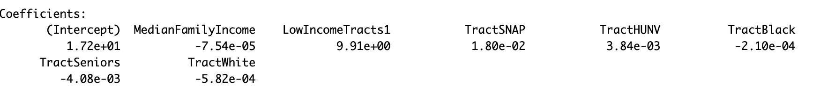
Linear Regression
R2 : 0.63682
RMSE : 7.4614

